Slide 1

National Reporting Platform
Quick Start Guide

Slide 2
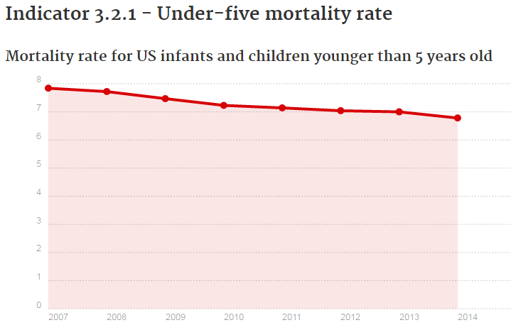
What is a National Reporting Platform (NRP)?
A tool to report national statistics and metadata for the SDGs
An integrated website,
Databases, and
IT infrastructure.
Notes:
An NRP refers to an integrated web site, databases, and associated IT infrastructure to gather, host, secure, and display information. An SDG NRP is a tool to report national statistics, metadata, and related information for the global Sustainable Development Goal (SDG) indicators.

Slide 3


Minimum Characteristics of an NRP
Managed by national statistical offices
Features official statistics and metadata
Is publicly accessible
Allows for feedback from data users
Features open source (free) technology
Notes:
Ideally, an SDG NRP has the following minimum characteristics to conform to the UN’s Fundamental Principles of Official Statistics.
-is managed by national statistical offices;
-features official statistics and metadata according to established standard methodology;
-is publicly accessible;
-allows for feedback from data users; and
-features open source (free) technology.

Slide 4

Why Choose an NRP?
An NRP makes it easy to
Gather,
Report,
Access, and
Communicate
Notes:
An NRP tool facilitates national reporting by improving communication. NRPs:
-Gather, disseminate, and track national data on the SDG indicators, including identification of data gaps,
-Report national data to be harmonized for international purposes (i.e., global indicator database),
-Improve access to official national statistics and metadata, and
-Improve communication between data providers, NSOs, custodian agencies, and other stakeholders.

Slide 5
What does the US NRP cost?
With minimal staff time
Nothing
Notes:
There is no cost associated with copying the US NRP and using it for your own country or region. Some NRPs are commercial, meaning there is a cost associated with using them. However, other NRPs, such as the US NRP, use open source technology. There are no hardware requirements, and the system and software requirements are free and minimal. The US NRP is hosted on the shared, free, open source collaboration platform called GitHub. Minimal staff time to copy, adapt, populate, and maintain the platform is also needed.

Slide 6
What are the IT requirements for the NRP?
Backend Requirements
GitHub: Use the website GitHub and install GitHub software. Host the NRP on either Chrome, Firefox, Safari, Microsoft Edge, or Internet Explorer.
Jekyll: Use Jekyll to construct your webpage on GitHub. It uses the coding language Ruby.
Prose.io: Use Prose.io to create, edit, delete, and save your content directly on GitHub.
Notes:
For developers, the only software requirement is to install Git on your personal computer. We recommend installing Ruby also so that you can test your NRP website locally. Data managers and data providers do not require software beyond a web browser (we find Chrome works best). More advanced users will want to install Git locally as well.
Backend Requirements
GitHub: Use the website GitHub and install GitHub software. Host the NRP on either Chrome, Firefox, Safari, Microsoft Edge, or Internet Explorer.
Jekyll: Use Jekyll to construct your webpage on GitHub. It uses the coding language Ruby.
Prose.io: Use Prose.io to create, edit, delete, and save your content directly on GitHub.
https://github.com/
https://help.github.com/desktop/guides/getting-started/installing-github-desktop/#platform-mac
https://help.github.com/articles/supported-browsers/
http://jekyllbootstrap.com/
http://jekyllrb.com/docs/installation/
https://www.ruby-lang.org/en/downloads/
http://prose.io/
https://github.com/prose/prose

Slide 7
What are the IT requirements for the NRP?
Frontend Requirements
U.S. Web Design Standards: U.S. Web Design Standards provides guides for developers and designers with design resources and code.
Chartist.js: Chartist is a charting library that offers customizable and responsive charts.
Notes:
U.S. Web Design Standards: U.S. Web Design Standards provides guides for developers and designers with design resources and code.
Chartist.js: Chartist is a charting library that offers customizable and responsive charts.
https://standards.usa.gov/
https://gionkunz.github.io/chartist-js/

Slide 8

What are the IT requirements for the NRP?
Recommended Skills
GitHub, Git, and basic web development (html and CSS)
Javascript and Ruby
Notes:
-Proficiency in Github, Git, and basic web development (e.g., html, css in order to set up the tool and repository).
-Proficiency in Javascript and Ruby to develop the tool.

Slide 9
How Do We Create Our Own NRP?
Step 1: Start with GitHub
Step 2: Fork or “copy” the NRP code
Step 3: Customize your NRP
Step 4: Turn the NRP code into a website

Slide 10

Case Study: the UK
Notes:
The UK copied and customized the US NRP code in about week. They streamlined code for their purposes, reviewed data formats, improved chart visualizations, and began enhancement to navigation. The US and the UK now are working together to enhance the platform. All of these enhancements will be shared freely with other countries. For more information on how the UK forked and customized their NRP platform, visit <https://github.com/datasciencecampus/sdg-indicators/issues/31> or contact their team at sustainabledevelopment@ons.gov.uk.

Slide 11
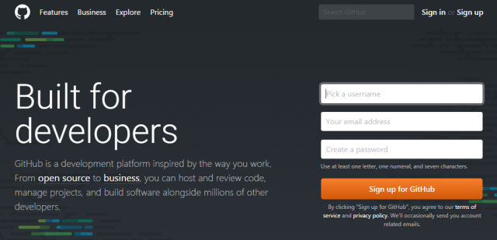
Step 1: Start with GitHub
A. Create a GitHub account
B. Learn the basics of Github
Try this introductory webinar and these resources.
C. Set up your GitHub organization and ID relevant users of your IT team
Image from GitHub.com
Notes:
Step 1: Start with GitHub.
-Create a GitHub Account.
-Go to github.com and create an account.
-Learn the basics of GitHub.
Try this introductory webinar and these resources.
-Set up your GitHub organization and identify relevant users of your IT team.
Then Register your organization with GitHub if not already registered. IT team members should set up their own GitHub accounts.
Tip: Within a GitHub organization, you can define ‘teams.’ This can be a useful way to identify users who are part of the project, improve communication among team members, and set specific permissions. See this guide to learn more.
https://www.youtube.com/watch?v=uNa9GOtM6NE
https://www.digitalgov.gov/2014/06/11/the-api-briefing-quick-guide-to-using-github-fdas-openfda-research-project/
https://help.github.com/articles/creating-a-new-organization-from-scratch/
https://help.github.com/articles/creating-a-team/

Slide 12

Step 2: Fork “copy” the Code
A. Go to either the US or the UK GitHub platform
Click the ‘fork’ button at top right.
B. Your NRP website address will be created at https://<YOUR-ORG>.github.io/sdg-indicators/.
Notes:
Sign in to GitHub and go to either the US or the UK platform and click the ‘Fork’ button at the top right. This creates a complete copy of the code and the statistics. This power point presentation and webinar walk through each step.
Your own NRP website address will then be named https://<YOUR-ORG>.github.io/sdg-indicators/. Note: You must complete the steps below before your NRP will function.
https://github.com/gsa/sdg-indicators
https://datasciencecampus.github.io/sdg-indicators/
https://github.com/datasciencecampus/sdg-indicators

Slide 13

Step 3: Customize your NRP
A. Edit configuration files
B. Grant prose.io access to the repository
C. Remove the US statistics and metadata
Notes:
-Edit configuration files.
-Grant prose.io access to the repository.
-Remove the US statistics and metadata from the repository. The US NRP currently files both the platform code and the SDG statistics and metadata in the same repository (or folder). This means that forking the US NRP will copy both the US data and its style sheets. Therefore, countries will want to remove the US statistics and metadata from their copy of the US NRP. See the script in Python the UK used to do this. The script can also be written in R (free statistical software).

Slide 14
Step 4: Turn the code into a website
A. Learn how to host a website with GitHub here.
B. To convert a forked NRP into a website, go to Settings and switch to Master Branch under GitHub pages.
404
Notes:
-Learn how to host a website with GitHub here.
-To convert a forked NRP into a website, go to Settings and switch to Master Branch under GitHub pages. This generates a 404 link for your NRP website.
https://www.youtube.com/watch?v=bwThn0rxv7M&list=PLm_Qt4aKpfKijgP0rDH7FSJOlS9IBGbT1&index=1

Slide 15
How Do We Put Our Own Statistics into the NRP?
Step 1: Conduct a needs assessment
Step 2: Id data providers
Step 3: Train data providers
Step 4: Verify the submitted data
Step 5: Report national statistics
Notes:
In addition to hosting the NRP, we used GitHub to collect input from data providers and maintain version control using five basic steps. You can customize your approach as needed.

Slide 16

Step 1: Conduct a Needs Assessment
A. Convene an expert group of SDG policy and statistical agency experts
B. Distribute a needs assessment survey to the expert group
Feel free to use the one we developed
Notes:
-To assess availability of national data for reporting SDG indicators, we convened an Expert Group. This includes 1) policy experts who have contributed to the formulation of sustainable development goals, targets, and the specification of indicators and 2) Federal statistical agency experts engaged in the production of official Federal statistics relevant to the SDG indicators or contribute to the specification of SDG indicators.
-This is the web-based survey (link under “USG SDG Data Needs Survey”) we distributed to our Expert Group for our assessment.
https://gsa.github.io/sdg-indicators/training/

Slide 17
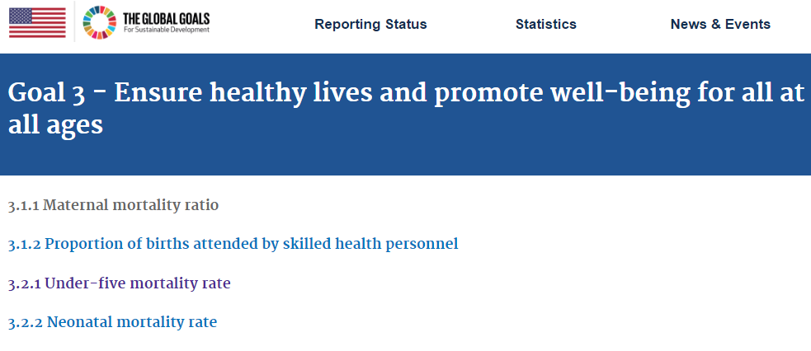
Step 2: Identify the Data Providers
A. Id both statistical and policy experts for the different kinds of indicators
B. Be prepared to ID proxies for indicators
Notes:
-The Expert Group identifies Federal data providers for each indicator for which Federal data are available. For statistical indicators, data providers are staff from Federal statistical agencies. For non-statistical indicators, data providers are generally staff from Federal policy agencies.
-In some cases, the US is not able to identify suitable official data sources to calculate official national statistics for SDG indicators. In a portion of these, the US reports official statistics for similar (i.e., proxy) indicators. These are noted in the NRP national metadata under “Actual Indicator Reported.” In other cases, the US examines other, non-official data sources to assess their quality. If found suitable, the US documents (or “curates”) the data source, calculates an official statistic, and provides the appropriate metadata.

Slide 18
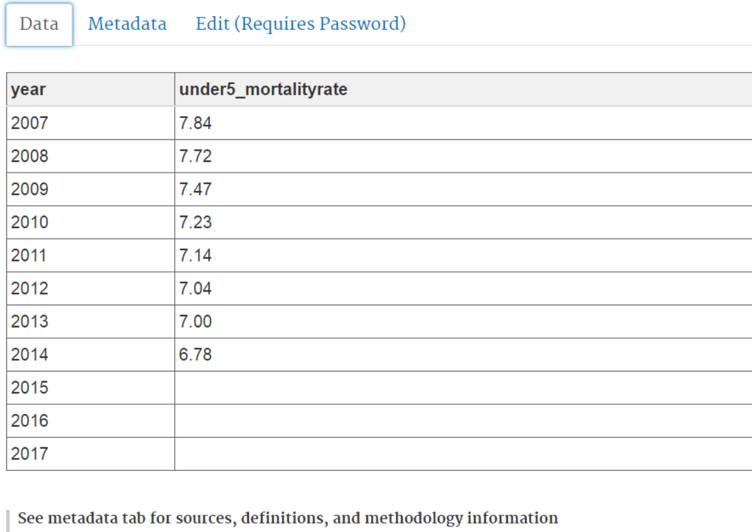
Step 3: Train Data Providers to Input National Statistics
Notes:
-Data providers submit statistics through their GitHub accounts using a spreadsheet interface.
-For each indicator, data providers also submit national metadata to accompany the global metadata provided by UNSD. For a detailed explanation of how the US trained its data providers, watch this webinar or read this training manual.
https://www.youtube.com/watch?v=gPq3jB_sfFw
https://github.com/GSA/sdg-indicators/issues/457

Slide 19
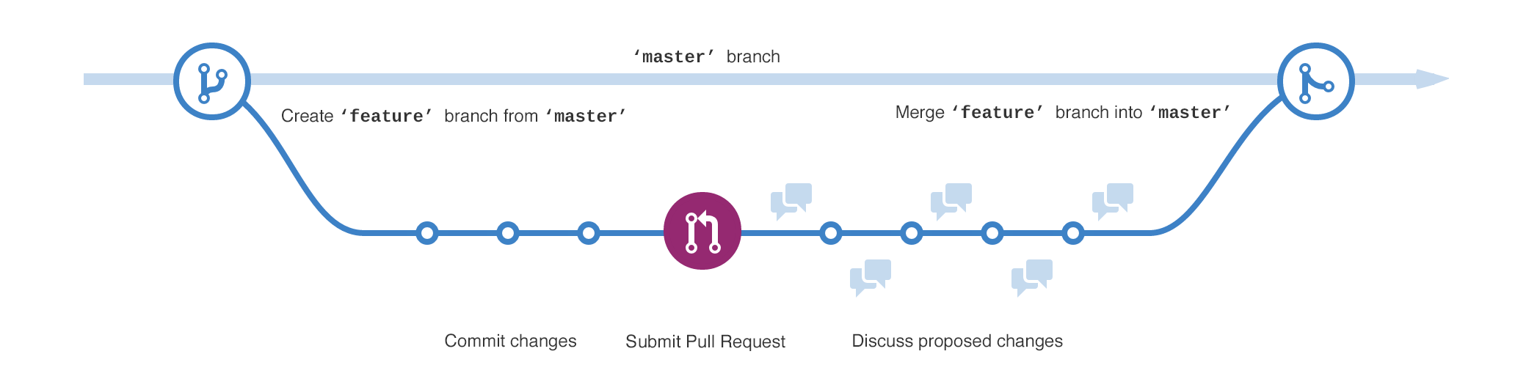
Step 4: Verify the Submitted Data
All data submitted by providers is routed to a non-public GitHub staging area for your review and approval
Image from GitHub.com
Notes:
-Statistics and metadata submitted by providers are routed to a non-public staging area on GitHub for review. Then, a notice is sent to reviewers by email from GitHub.
-You authorize reviewers of submissions. When an email notice is received, the reviewer clicks on a GitHub link included in the email, and then selects a specific review (or ‘pull’) request. The data provider and her/his exact changes will be visible to your reviewer.
-Reviewers examine submissions for incompleteness or function errors. They can then approve by clicking on ‘Confirm Merge,’ request clarifications or additional information from data providers using ‘Comment,’ or disapprove by clicking on ‘Close.’

Slide 20

Step 5: Report National Statistics
A. After your approval, the data will be publicly viewable
B. Here is a guide on how to refresh your master site with content from the staging area
Notes:
-After you have approved the submission from your data provider, the statistics and metadata will be viewable to the public.
-In the US, we update our NRP through a clearly marked ‘staging’ or testing site before merging with the ‘master,’ or official site that the public can find online. This guide describes how to refresh the master site with content from the staging site.

